Slide 1
Quality Council
April 2023
Notes:
Title Slide

Slide 2
Agenda
Quality Council
Reliability & Warranty Way forward
Reliability & Warranty Update
Decision / Summarize

Slide 3
Quality Council
Objective : Strategic Business decisions related to Quality
Chairperson | MD
Members | COO
 | CTO
 | Head – MHCV Business
 | Head – Growth Business
Deliverables :
Accelerated Warranty cost & Customer issue reduction
Quicker resolution actions through Supplier
Apex level decisions - Regulation & PPRM escalations
Direction based on Customer feedbacks and Survey
Invitees : Head Mfg, Head Sourcing and relevant stakeholders shall participate accordingly.
Secretariat : Head Quality will centrally drive
Frequency: Bimonthly
Duration : One Hour

Slide 4
Warranty cost
Warranty Cost Per Vehicle in Rs. (3 MIS)
Warranty Cost Per Vehicle in Rs. (12 MIS)
Peak
Warranty expenditure in Rs. Cr
Inference
3 MIS WCPV has reduced by 6% from Jul’22, Will get reflected in 12 MIS from FY24 Q3.
Major actions implemented for top WCPV contributors – Axle casing, Wheel disc, UDS, Lift axle, CWP etc.
Parc
3.42L
3.32L
2.63L
1.94L
2.23L
Overall warranty expenditure is inclusive of tax & spares margin Tax & spares margin contributes to 40%

Slide 5
Reliability
Failure Per Vehicle (3 MIS)
Failure Per Vehicle (12 MIS)
Peak
Inference
3 MIS FPV has reduced by 8% respectively from Jul’22, Will get reflected in 12 MIS from FY24 Q3.
Towards FPV reduction,
Error code masking & de-bounce time increase in Albonair system. C:Mar’23
Parent child lock enabled for air leak verification. C: Mar’23.
Wheel alignment frequency increased. C: Dec’22.
System lock for preventing split claims and Wheel alignment claims. T: May’23

Slide 6
Reliability & Warranty Way forward
Reduction of Warranty Cost
Reduction of Unscheduled visits
Improve Speed of issue resolution

Slide 7
Reduction of Warranty Cost
Notes:
Agenda Slide

Slide 8
FY24 - Estimated Warranty Cost reduction
Aggregate wise 12 MIS WCPV
Top complaints
Realisation start from Sep’23
19735
Clutch pack
12 MIS WCPV
Expected reduction is Rs.3118/Vehicle (excluding clutch pack)
Clutch contribution is Rs. 3271/Vehicle
*Based on Jan ‘23 data

Slide 9
Clutch WCPV trend
Effect of COVID
WCPV increasing trend in BS VI model
Notes:
Content Slide

Slide 10
Clutch failure Model wise
Luk330 – 8.23 Cr
Luk395 – 14.03 Cr
Setco 380 – 12.29 Cr
High failure rate observed in 250HP application (395 dia. clutch ) followed by 380 dia. clutch failures in 200HP application
BS6 Failure data up-to Feb’23
Values in Cr

Slide 11
200HP and 250HP Sales distribution
250 HP (395 dia. Clutch) sales volume is increasing month on month.
200 HP (380 dia. Clutch) sales volume is sustained
Notes:
Content Slide

Slide 12
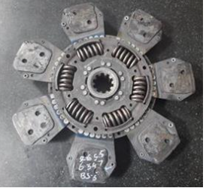
Clutch Failure mode wise distribution

Slide 13
Clutch failure – Manufacturing/Supplier Actions Status
7 3
Engine GB alignment fixture to improve clutch life.
Datum Surface creation. T. May’23
Fixture modification T.Jul’23
Lifting hoist with hook arrangement introduced at H2 & PNR. C: Sep’22. Alwar & Ennore. T: May’23.
Clutch handling process/packaging improvement at Supplier end. T: May’23

Slide 14
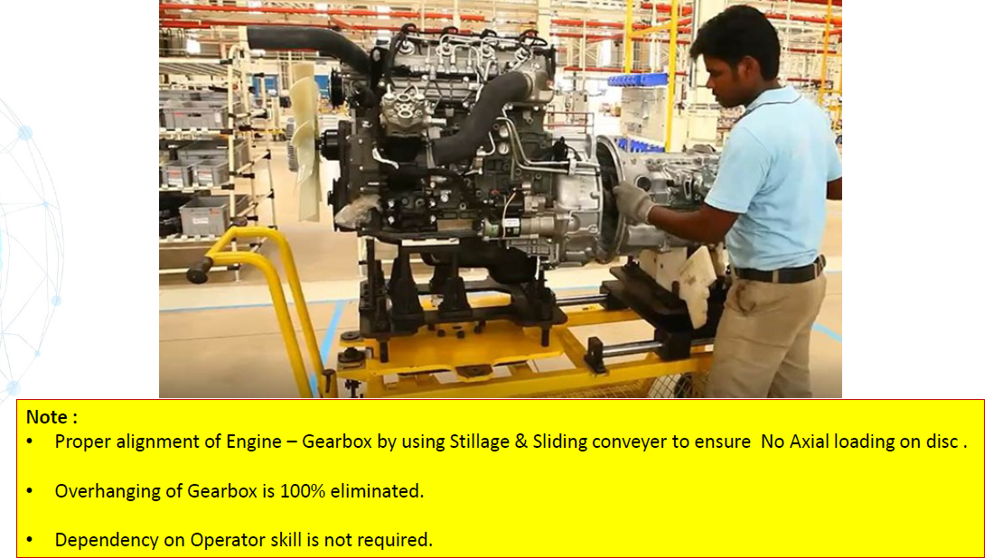
Clutch failure – Manufacturing Actions Status
Competitor Benchmarking –Sliding Conveyer System
7 3

Slide 15
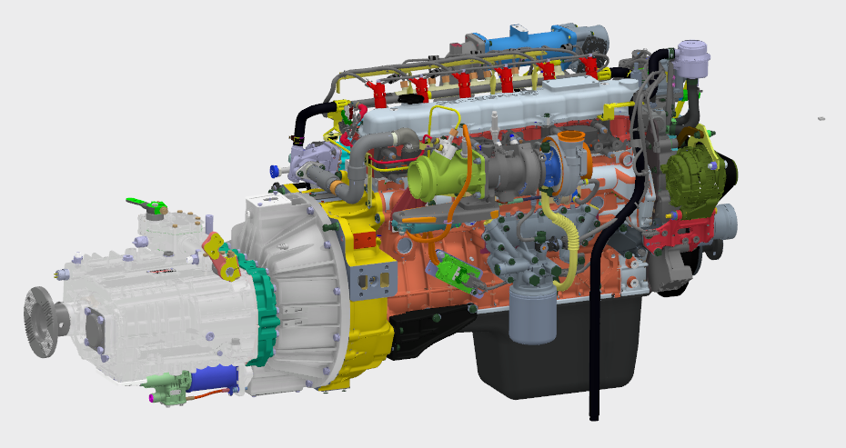
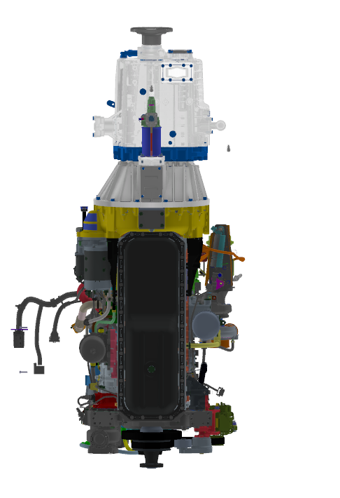
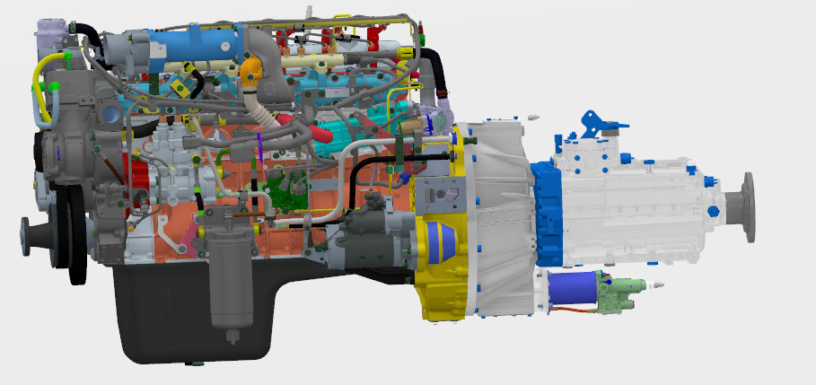
Clutch failure – Manufacturing Actions Status
7 3
Machined holding surface Requirement:
Five places in Engine – Size : 50 mm x 50 mm
Five places in GB – Size: 50 mm x 50 mm
As indicated in these DMU images

Slide 16
Clutch failure – Design Actions Status
4 3
Luk 395 dia Clutch burnt:
8 pad rigid ceramic clutch disc introduction in place of current 7 pad cushioned ceramic disc. LuK – T: Jul’23; Setco – T: Aug’23
Spec release planned for 430 dia Clutch in Tippers. T: Aug’23 (A4) & Sep’23 (H6 4V)
Luk 330 Clutch burnt in E1615:
362 dia Clutch is under development for 1916 Haulage / 1615 Tipper model. After development, to be taken up for horizontal deployment in 1615/ 1815 models

Slide 17
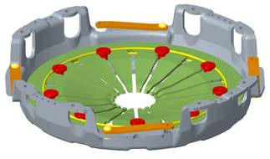
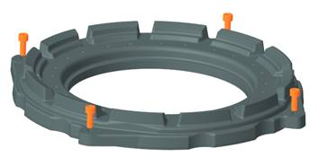
Clutch failure – Service Actions Status
2
Clutch Kit part usage in field against failures, % usage to be improved.

Slide 18
Clutch failure – Service Actions Status
2
2) Clutch burnt cases:
Gradual reduction of warranty acceptance by more informed decisions through
Warranty decisions by Service Engineers
Proximity of i-alert data for usage by Service Engineers
Using AI providing alert to the Driver/Customer for incorrect driving practice
Competition Benchmark:
Clutch Burnt Cases | TML | BB
Warranty Practice for Clutch burnt cases | No Warranty is provided | No Warranty is provided (Warranty is provided based on Top Mgmt approval for one BS6 model recently due to some pickup/ gradeability issue. In General, warranty is not entertained for burnt cases. Even if the parts are received at Plant, it will be debited back to Dealer by quoting it as abuse)

Slide 19
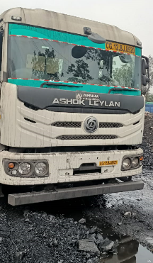
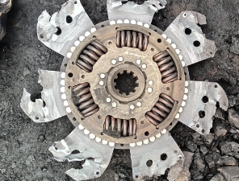
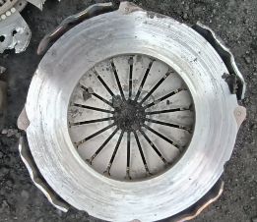
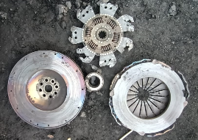
Clutch burnt
Kandhari Transport - Korba
Complaint reported: Gear not engaging
Field observation: Vehicle running in coal application (Tip Trailer).
Clutch burnt & ceramic pads chipped off
Chassis | MB1TZVLD8PPMV2352
Veh model | N5525A A 9SZF L1R1 R4 PHY ELC 03CBC
DOS | 28-Feb-2023
DOF | 07-Apr-2023
Failed km/ hours | 1043 kms/ 67.5 hours
Location | Korba
Application | Coal
Operating GVW | 54T
Clutch Plate
Cover Assy
Vehicle BD location
Clutch plate, cover assy and Flywheel
Notes:
Content Slide

Slide 20
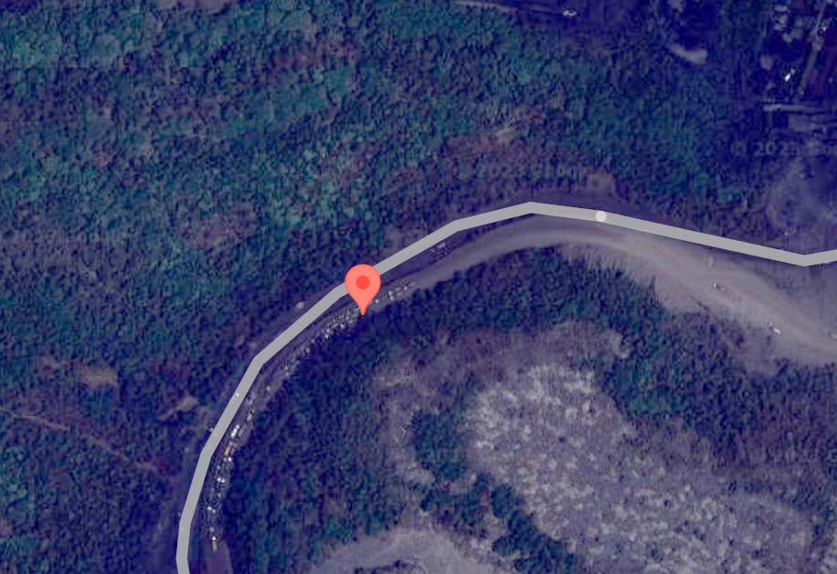
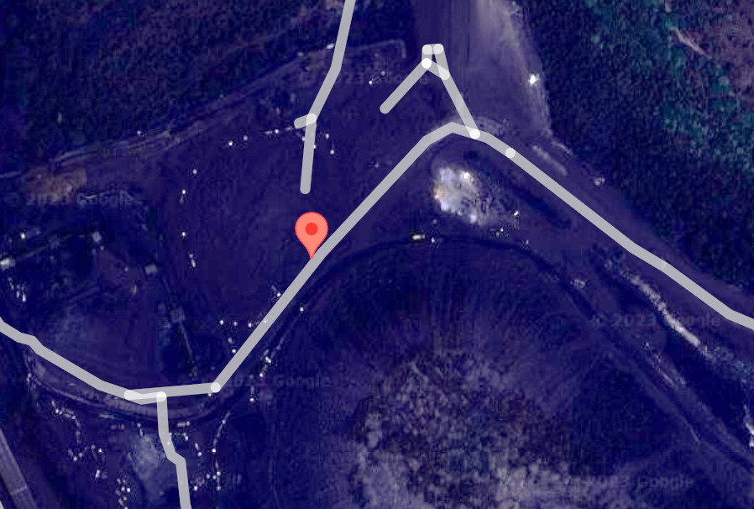
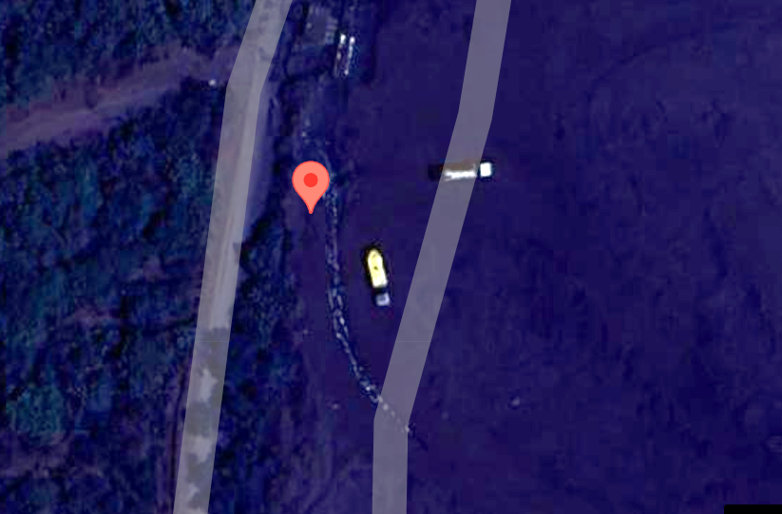
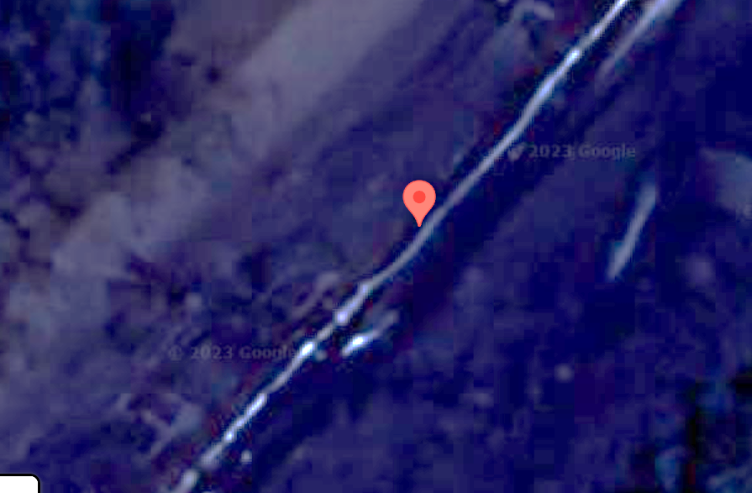
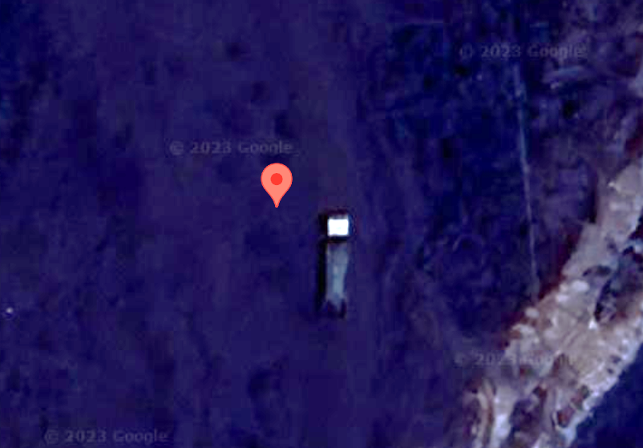
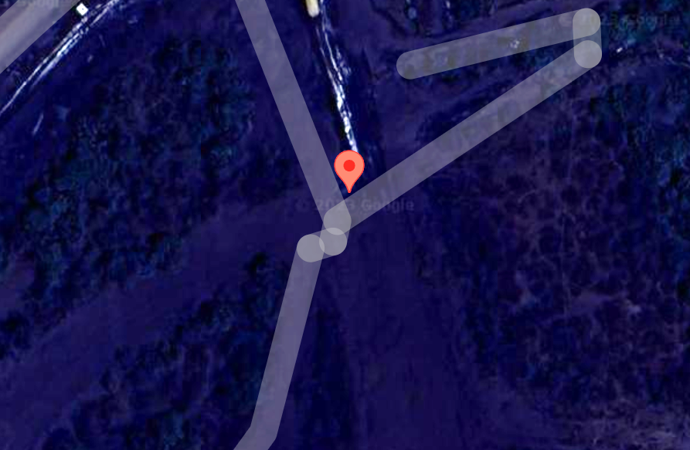
Vehicle operating route
06-04-2023 14:18:34
06-04-2023 16:04:44
06-04-2023 20:34:43
06-04-2023 21:23:46
06-04-2023 23:00:00
07-04-2023 13:20:26
Understood from Field Team that vehicle operating roads are with coal deposits due to which Drivers may tends to drive with partial clutch press

Slide 21
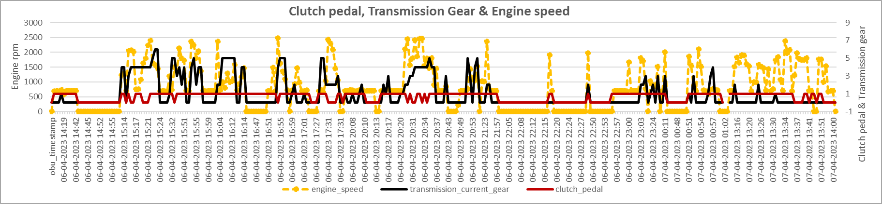
I Alert data study
I alert data studied for 7 days (01-Apr-2023 to 07-Apr-2023) and found vehicle was operated 57% of time in clutch partial pressed condition (178 km run in above 7 days).
A sample data projected below
Clutch pedal pressed during vehicle run
Vehicle operated 57% of time in clutch partial pressed condition

Slide 22
Clutch failure – Application Actions Status
1
Clutch burnt cases – Driver education on
Clutch riding
Vehicle launch in correct gears
Frequent Clutch drop
Correct usage of IAD lock, etc.
New technology: Clutch by wire can be taken forward to reduce operational abuses

Slide 23
Clutch failure – Action status & summary
AL Manufacturing
Engine GB alignment fixture to improve clutch life. a)Datum Surface creation. T. May’23
b) Fixture modification
T.Jul’23
Lifting hoist with hook arrangement introduced at H2 & PNR. C: Sep’22. Alwar & Ennore. T: May’23.
Supplier process
Clutch handling process improvement at Supplier end. T: May’23
Design
Luk 395 dia clutch – EDM released. T: Jul’23 and Setco 395 dia. Clutch – EDM released T: Aug’23
430 dia Clutch in Tippers. T: Aug’23 (A4) & Sep’23 (H6 4V)
For 1916 / 1615T model, 362 dia clutch is under development. After development, to be taken up for horizontal deployment in 1615/ 1815 models
Service
Clutch Kit part usage in field against failures, % usage to be improved.
Warranty decisions by Service Engineers
Proximity of i-alert data dashboard for usage by Service Engineers
Using AI providing alert to the Driver/Customer for incorrect driving practice
Application
Clutch burnt cases – Driver education on
Clutch riding
Vehicle launch in correct gears
Frequent Clutch drop
Correct usage of IAD lock, etc.
Expected reduction with all above actions is Rs. 2618/Vehicle
Expected reduction with manufacturing and design action is Rs.935/Vehicle

Slide 24
Reduction of Unscheduled visits
Notes:
Agenda Slide

Slide 25
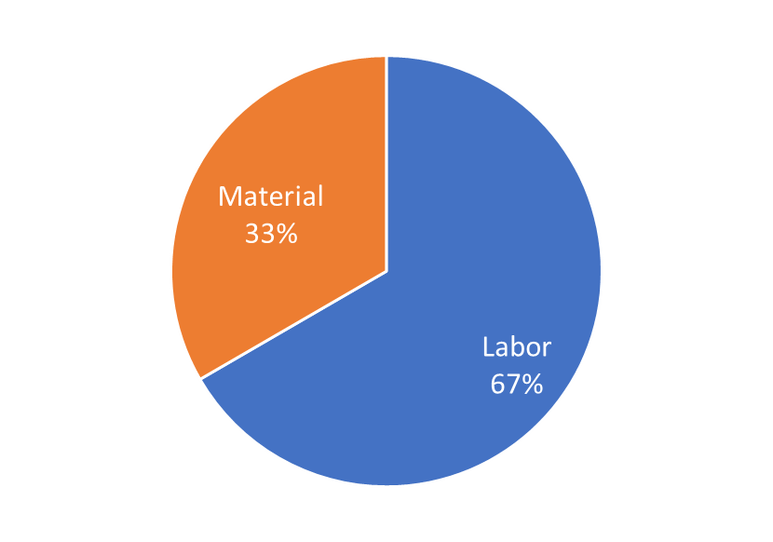
Unscheduled visits – Failure trend
Unscheduled visits Trend (3 MIS Wise)
Unscheduled visits (12MIS) Claim Type wise
Unscheduled visits Trend (12 MIS Wise)
Irritant
3 MIS USV was stable from FY23 Q2 and started reducing in Feb’23, 12 MIS will follow.
67% of USV are due to pure labor attentions, getting clarity on problem definition is a challenge.

Slide 26
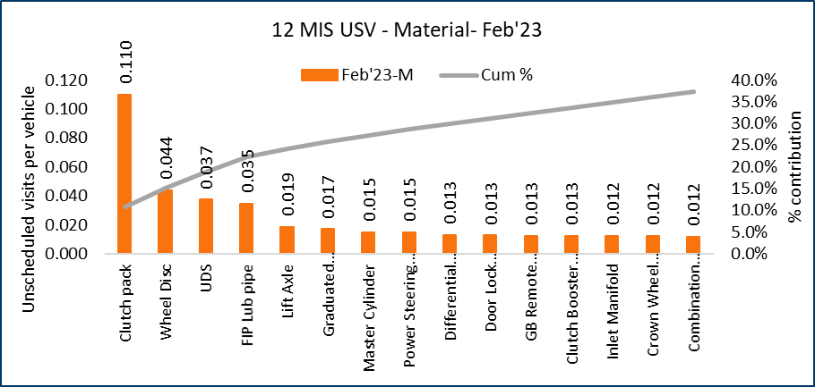
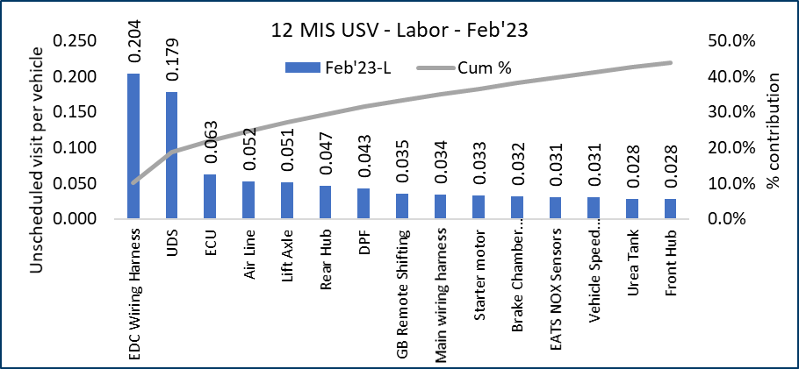
Unscheduled visits Pareto
Data up to Feb’23
Material claim type - Pareto
Irritant complaints- Pareto
12 MIS USV – Irritant complaints– Feb’23
Material claims - Actions implemented/under implementation for majority of the complaints.
67% of USV are irritant complaints. Top 15 complaints contribute to 45% of USV.
Note: 13 Unscheduled visit projects initiated during FY23, actions implemented/ under implementation for 85% of projects
Common between Material & irritant complaints pareto

Slide 27
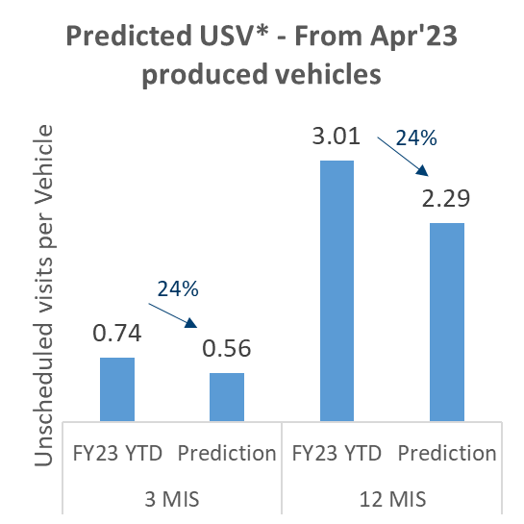
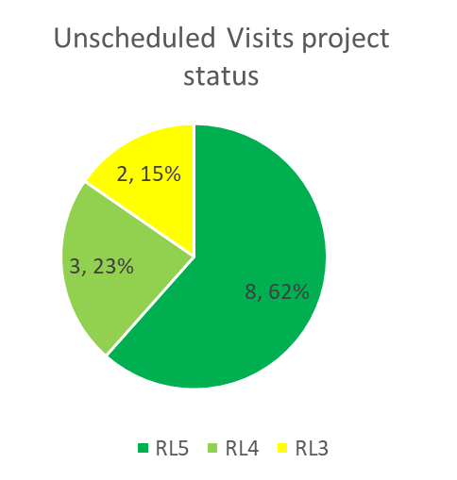
Unscheduled Visit Projects Status – FY23
Total number of projects: 13 (Resolution through APS/BPS methodology)
Project | Project leader | T / C | Status
EDC / ACU – Error code related issues | Sudhakar P Sivanantham P | Jun’23 | RL4
Reduce unsch. visits due to vehicle speed sensor | Guhan P T | Jan’23 | RL5
Reduce unsch. visits due to NOx sensors | Sivanantham P | Aug’22 | RL5
Reduce unsch. visits due to UDS pump | Sivanantham P | Aug’22 | RL5
Reduce unsch. visits due to HC injector | Sivanantham P | Aug’22 | RL5
Reduce unsch. visits due to Pneumatic connectors & systems | Jeyaprakash B | Jun’22 | RL5
Reduce unsch. visits due to Power steering hose/reservoirs | Jeyaprakash B | Apr’22 | RL5
Reduce unsch. visits due to Found. brakes (Liner, drum, ASA, Cam) | Jeyaprakash B | Jun’23 | RL3
Reduce unsch. visits due to steering pump | Jeyaprakash B | Nov’22 | RL5
Reduce unsch. visits due to Gearbox CSO | Rajesh Kumar | Jul’23 | RL3
Reduce unsch. visits due to Front hub/ rear hub/ kingpin/ dist. piece | Raghuraj | Apr’23 | RL4
Reduce unsch. visits due to Lift axle | Akshay | Dec’22 | RL5
Reduce unsch. visits due to Fuel/leak off pipes | Raja G | Jun’23 | RL4
Project status as on 20.04.2023:
*Expected reduction based on actions implemented via projects and resolution of top contributors
Actions implemented / under implementation for 85% of projects
Major actions taken
Way forward
Actions implemented for UDS pump (CEME pump intro.), Nox sensors, HC injector (Adaptor design change), Vehicle speed sensor, Pneumatic connectors & systems, Power steering hoses/reservoirs, Foundation brake, steering pump & Lift axle failures.
Error code lamp masking / de-bounce time increase – Albonair system – C: Mar’23.
Actions under implementation for EDC/ACU error, fuel pipes, Front hub/rear hub and Gearbox CSO failures.
Error code lamp masking / de-bounce time increase – Cummins system; T: May’23

Slide 28


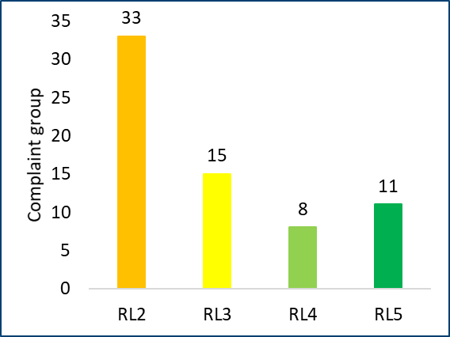
USV reduction - Way forward
Top 15 USV irritant complaint pareto
12 MIS USV – Irritant complaints– Feb’23
RL2 – Identification of Root cause
Scope
RL3 – Identification of corrective action
Approach
Irritant complaint (Top 80% contributors) - RL Status
PPRM /
QIC
33 complaint groups are in RL2 state, to taken up as project for resolution
80% effectiveness will bring down irritant complaint by 1.3 visits/vehicle.

Slide 29
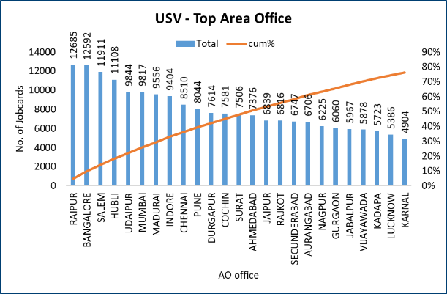
Unscheduled Visit – Dealer wise Pareto
Top 5 area office contributes to 20% of visits. (comprising of 135 dealers).

Slide 30

USV reduction - Way forward Project proposal
Steering Committee
(COO/CTO/Head-MHCV)
Monthly review
Fortnightly review
Head - CQ
Weekly review
QIC
Project Mentor – TBD
Area Office wise visits
Raipur
Bangalore
FQ - Functional Excellence
FQ Vertical heads
Salem
Hubli
Udaipur
Top 5 area office to be visited for analysis – 3 executives / area office to be assigned for 3 months.

Slide 31
Improve Speed of issue resolution
Notes:
Agenda Slide

Slide 32
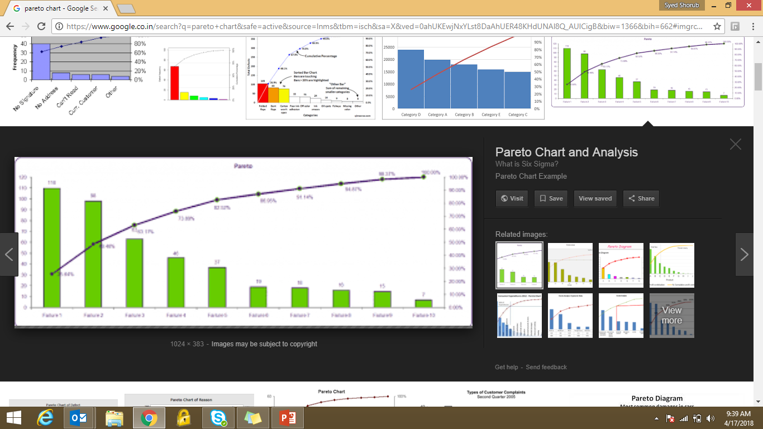
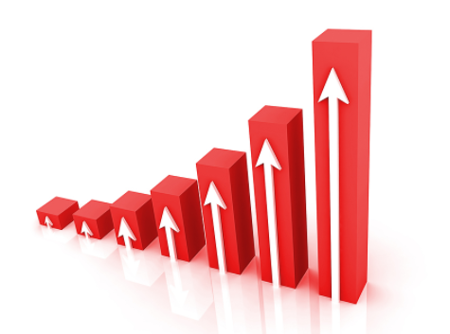
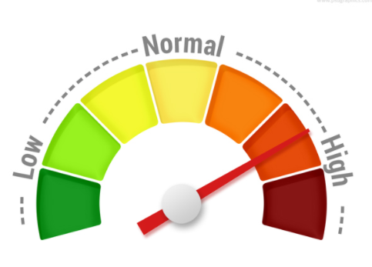
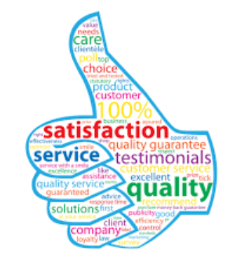
Field issue complaint resolution process
Inputs
Process
Outputs
Create
PA
RCA
CA
IMP
CA Eff
Close
Increased reliability & durability
Warranty claims
SAP
Prioritize by Pareto
PPRs
Product issues (PLM)
QIC
Grade 1
Customer satisfaction
Grade 5
Emails
Early warning
Safety critical
Quick Resolution
PLM
PPR – Product Performance Report
QIC – Quality Improvement Committee
PLM – Product Lifecycle Management

Slide 33
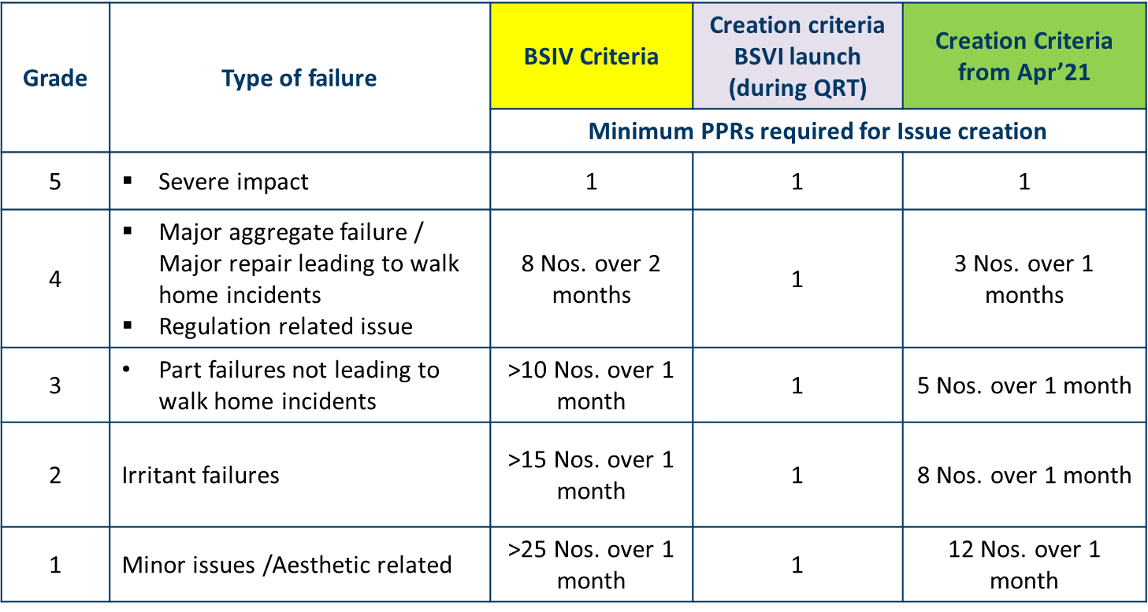
PLM issue resolution – Criteria & Timeline
Issue Creation Criteria
Time line
BS4 timelines:
Grade |  | 5 | 4 | 3 | 2 | 1
Supplier (Process) Related | Simple | 45 | 55 | 125 | 130 | 130
 | Complex | 100 | 125 | 155 | 160 | 160
Design related | Simple | 60-90 | 85-115 | 125-155 | 145-175 | 145-175
 | Complex | 90-120 | 115-145 | 140-170 | 160-190 | 160-190
Manufacturing related | Simple | 45 | 55 | 125 | 130 | 130
 | Complex | 100 | 125 | 155 | 160 | 160
Service related |  | 65 | 75 | 125 | 130 | 130
BS6 timelines:
During BS6 launch (FY21), Issue was created for every failure mode irrespective of the type of failure
Issue resolution timelines were also made stringent (From 45-190 days to 30-90 days).
Manufacturing | Supplier process | Design (AL/Supplier) & Application
30 | 60 | 90

Slide 34
PLM issue – Revised creation criteria
Maximize coverage of Customer complaints
Grade | Type of failure | Current criteria | Modified criteria
 |  | Minimum PPRs required for Issue creation
5 | Severe impact | 1 | 1
4 | Major aggregate failure / Major repair leading to walk home incidents. Regulation related issues. | 3 Nos. over 1 months | 2 Nos. over 1 months
3 | Part failures not leading to walk home incidents | 5 Nos. over 1 month | 3 Nos. over 1 month
2 | Irritant failures | 8 Nos. over 1 month | 8 Nos. over 1 month
1 | Minor issues /Aesthetic related | 12 Nos. over 1 month | 12 Nos. over 1 month
23% Customer issues coverage will increase with new criteria

Slide 35
Enhance Speed of Issue Resolution
Data as on: 31.03.2023
40% improvement from FY22
Key Progress / Achievement - FY23:
Involvement of Stakeholders right from the initial stages of analysis
Continuous daily management practice and timely decisions through QIC/PPRM
i alert data used for faster root cause analysis.
PLM process refinement carried out.

Slide 36
Speed of Issue Resolution - Action status (based on last 3 years):
Sl No | Challenges | Action summary | Cutoff / Target
1 | Implementation delay | Pre-EDM part cutover being discussed in QIC for decision S&SC to improve implementation percentage from 27% to 90% - to follow SOP for obsolescence, inventory alert to supplier & fast forward field failure EDM’s. Formation of Quick Action Committee involving Sourcing, Finance, PMG & QIC for quicker cost approval of improvement actions. | C: Feb’22
 |  |  | T: May’23
 |  |  | Q Council Approval
2 | Delay due to Cause or Action validation | Dedicated test bed for field failure validations – COP test bet to be shared Usage of validation tools (CAE / CTL analysis). All field conditions (application) to be considered for validations (Eg. Tippler, Tip-Trailer application) QIC to be empowered for implementation of actions based on risk assessment (case to case basis) and validation shall be carried out in parallel. | T: May’23
 |  |  | Continuous
 |  |  | Q Council Approval
3 | Delay due to issue complexity / Stakeholders acceptance delay | CFT approach (involved stake holders) being followed for all issues during initial stages of analysis & All issues with root cause are being discussed in QIC. Involvement of 3rd party agencies for failure analysis (IIT, external agencies etc.) PLM process changed (Multiple attribution can be assigned for a single issue) | Continuous
 |  |  | C: Mar’22 C: Nov’21
4 | Analysis delay (Supplier) | Weekly review with Suppliers (working level) and fortnightly review at management level for all proprietary suppliers (M/s Cummins, Bosch (B panel meeting), DTVS, Meritor etc.). 6 sigma project carried out at M/s Cummins to improve speed of resolution. Utilization of mfg plant lab / external sources for speeding up the analysis. | BSVI launch C: Jun’22 Continuous

Slide 37
Summarize / Decisions Box
Reduction of Warranty Cost - Clutch failure action implementation as CFT
Reduction of Unscheduled visits -
Top 5 area office to be visited for analysis – 3 executives / area office to be assigned for 3 months.
Improve Speed of issue resolution-
Formation of Quick Action Committee
QIC to be empowered for implementation of actions based on risk assessment (case to case basis) and validation shall be carried out in parallel.

Slide 38

Notes:
End slide

